Slide 1
AOC Final Presentation
第三組 - 大禹治水，小郭治洪

Slide 2

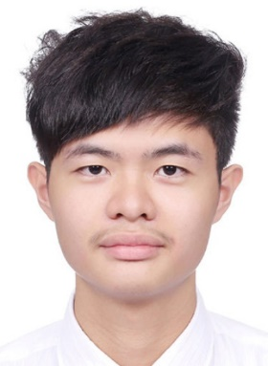
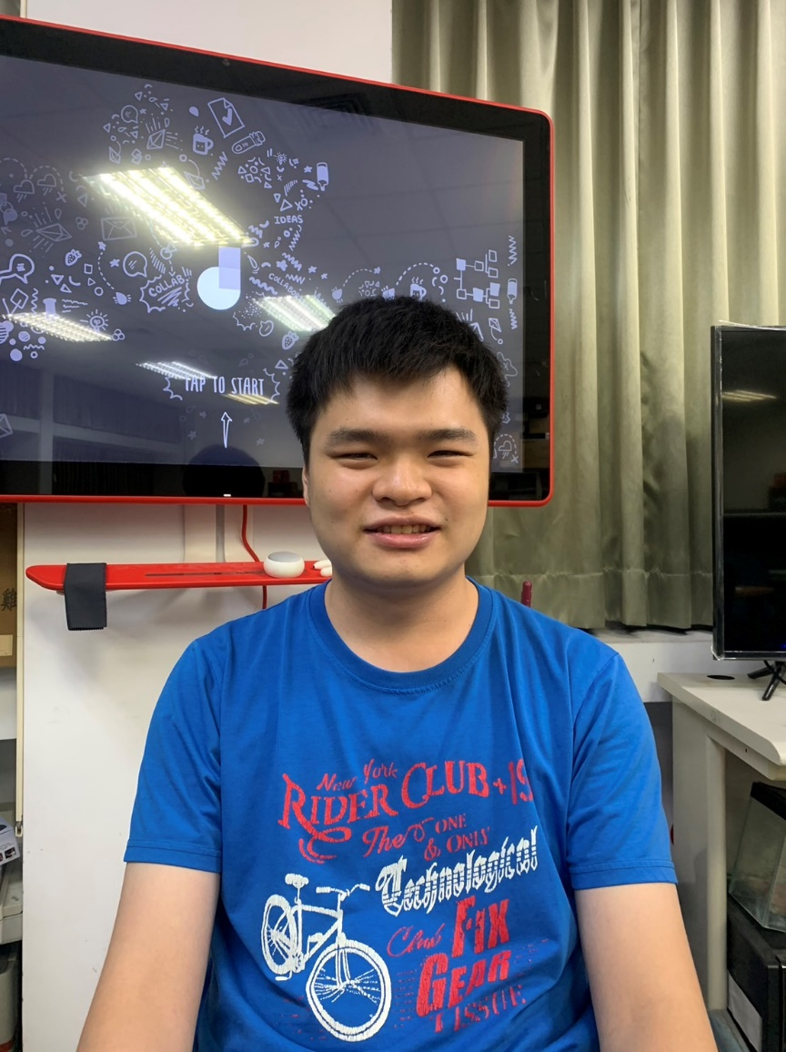
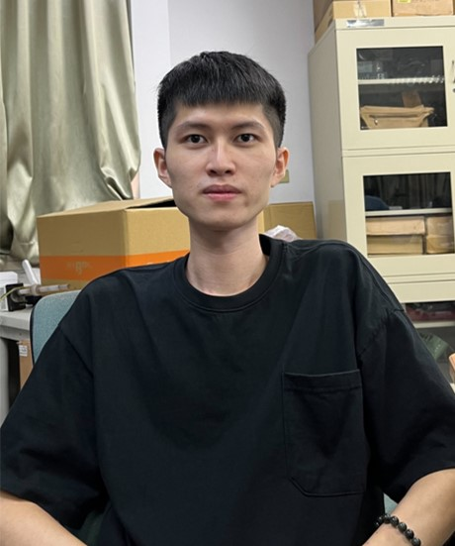
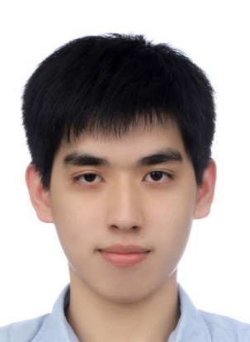
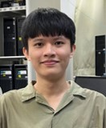
Member List
黃雍翔：H-swish、Horizontal buffer controller
陳冠穎：H-swish、Vertical buffer controller
王文楷：PE array、PE controller
蔡明翰：PE array、PE controller
胡家豪：Model training、Model Quantization

Slide 3
Outline
Software
Hardware
Results and Analysis

Slide 4
Outline
Software
Model Introduction
Quantization
Hardware
Results and Analysis

Slide 5
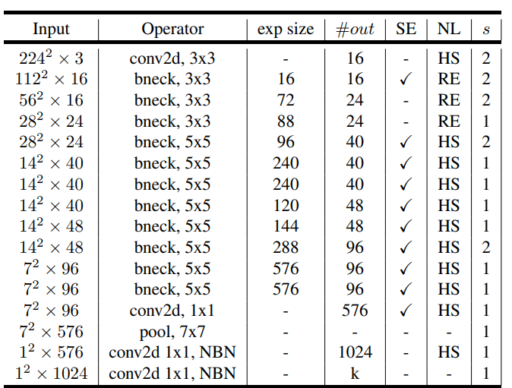
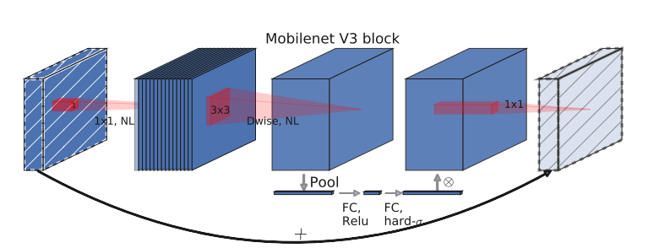
Model introduction - MobileNet V3

Slide 6
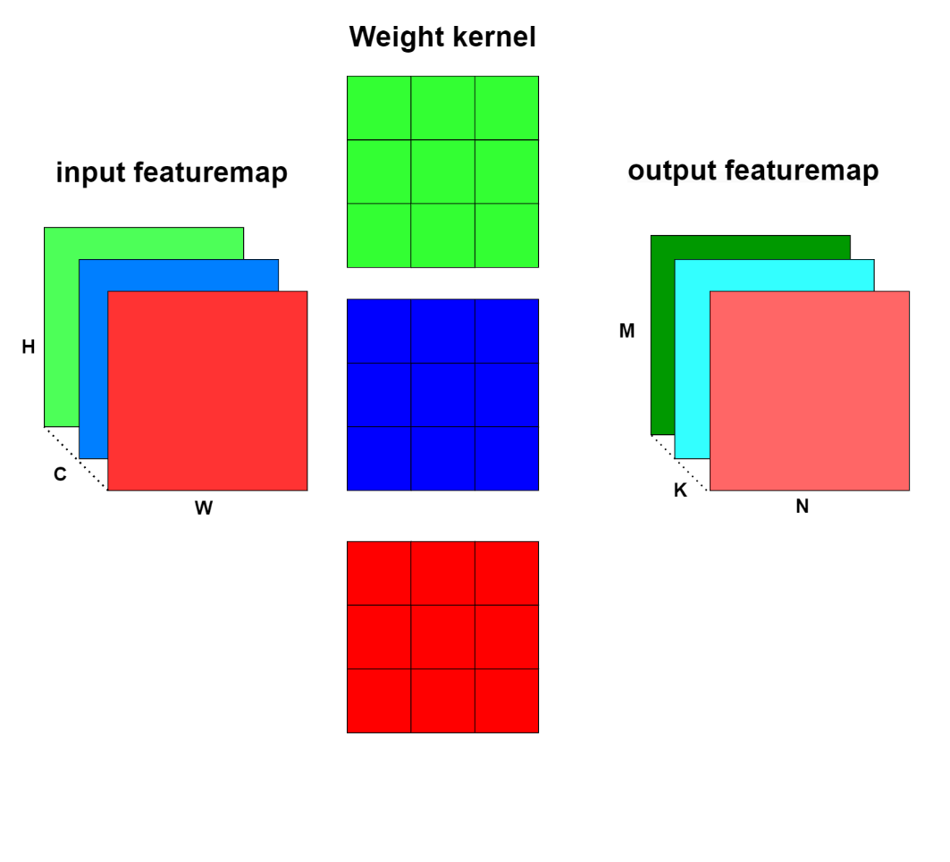
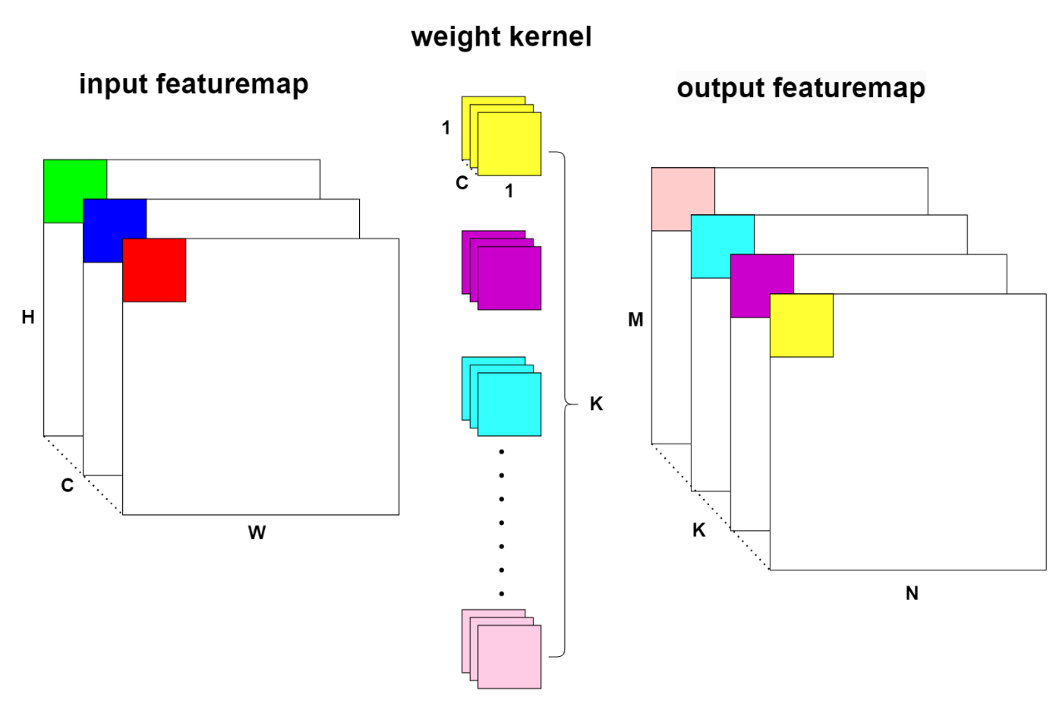
Model introduction
(a) Depthwise convolution
(b) Pointwise convolution

Slide 7
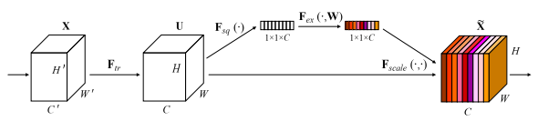
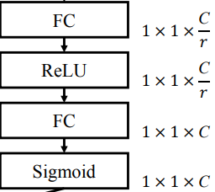
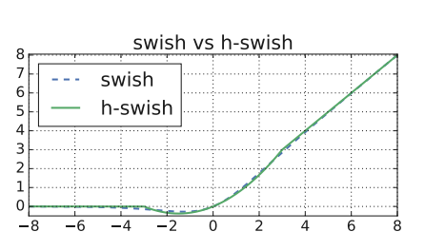
Model introduction

Slide 8
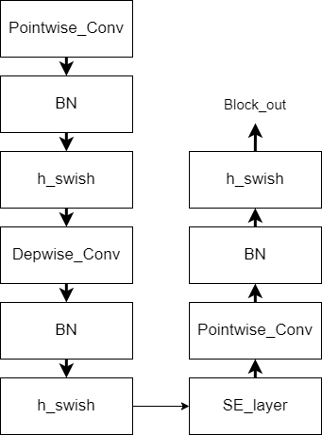
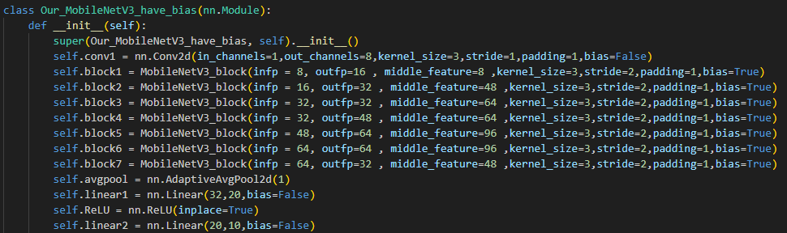
Model Build

Slide 9
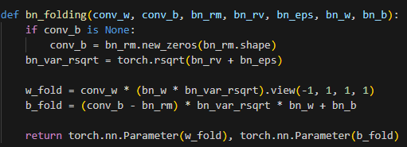
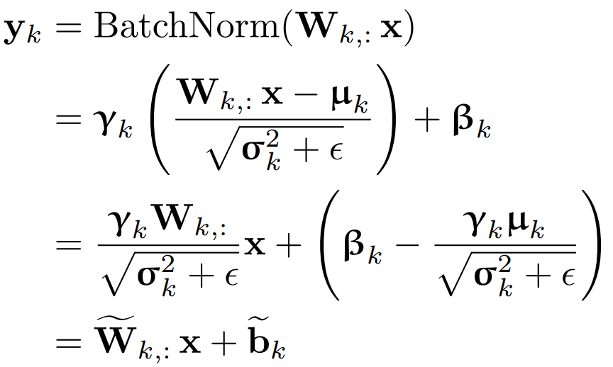
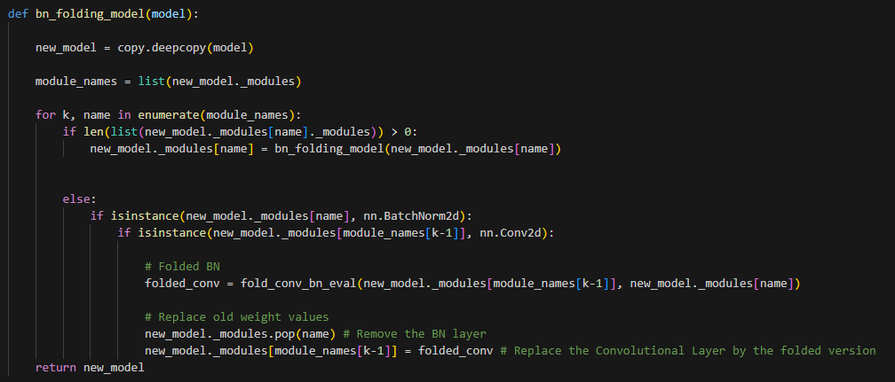
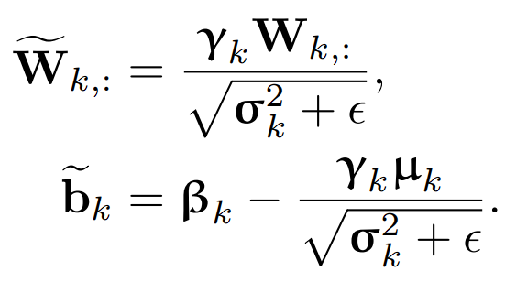
Quantization-BN fold
Batch normalization fusing:

Slide 10
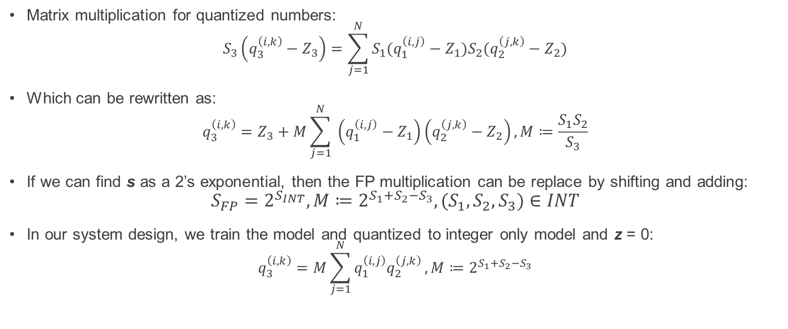
Quantization - Integer-only
Matrix multiplication for quantized numbers:
$$S_{3}\left(q_{3}^{\left(i, k\right)}−Z_{3}\right)=\sum_{j=1}^{N}{S_{1}(q_{1}^{\left(i, j\right)}−Z_{1})S_{2}(q_{2}^{\left(j, k\right)}−Z_{2})}$$
Which can be rewritten as:
$$q_{3}^{\left(i, k\right)}=Z_{3}+M\sum_{j=1}^{N}{ \left(q_{1}^{\left(i, j\right)}−Z_{1}\right)\left(q_{2}^{\left(j, k\right)}−Z_{2}\right)}, M≔\frac{S_{1}S_{2}}{S_{3}}$$
If we can find s as a 2’s exponential, then the FP multiplication can be replace by shifting and adding:
$$S_{FP}=2^{S_{INT}},M≔2^{S_{1}+S_{2}−S_{3}},{(S}_{1},S_{2},S_{3})∈INT$$
In our system design, we train the model and quantized to integer only model and z = 0:
$$q_{3}^{\left(i, k\right)}=M\sum_{j=1}^{N}{q_{1}^{\left(i, j\right)}q_{2}^{\left(j, k\right)}}, M≔2^{S_{1}+S_{2}−S_{3}}$$

Slide 11
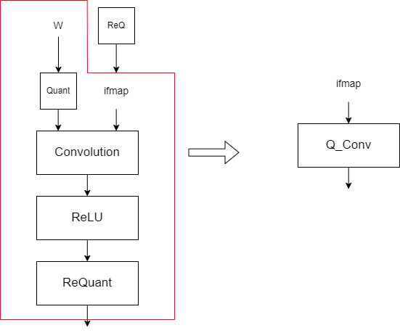
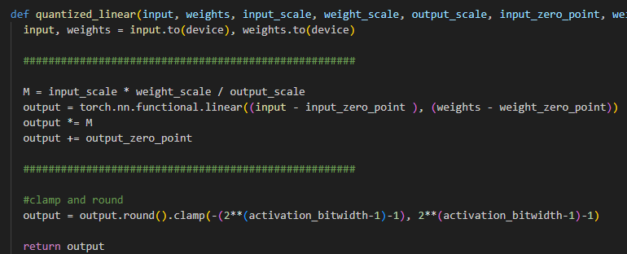
Quantization - Integer-only

Slide 12
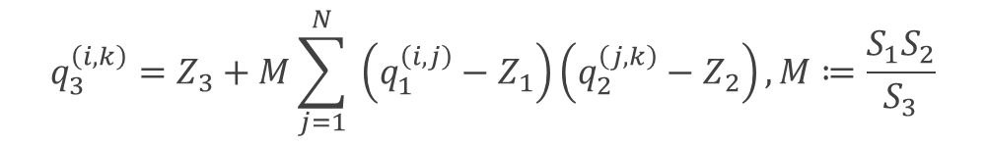
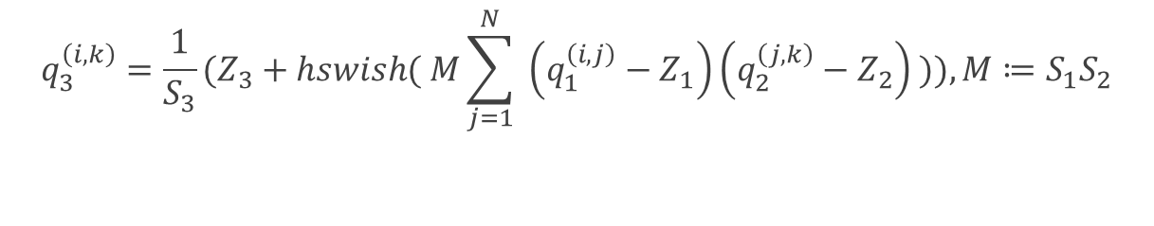
Quantization- Ours
Because of Swish, We can’t apply Integer-only quantization directly
$$q_{3}^{\left(i, k\right)}=Z_{3}+M\sum_{j=1}^{N}{ \left(q_{1}^{\left(i, j\right)}−Z_{1}\right)\left(q_{2}^{\left(j, k\right)}−Z_{2}\right)}, M≔\frac{S_{1}S_{2}}{S_{3}}$$
$$q_{3}^{\left(i, k\right)}={\frac{1}{S_{3}}(Z}_{3}+hswish( M\sum_{j=1}^{N}{ \left(q_{1}^{\left(i, j\right)}−Z_{1}\right)\left(q_{2}^{\left(j, k\right)}−Z_{2}\right) })), M≔S_{1}S_{2}$$

Slide 13
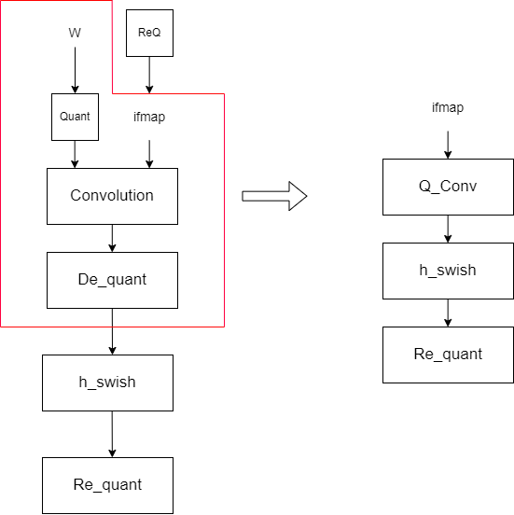
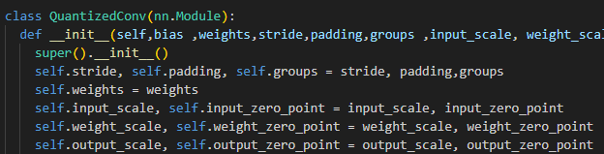
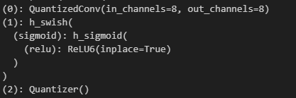
Quantization- Ours
Because of h-Swish, We can’t apply Integer-only quantization directly

Slide 14
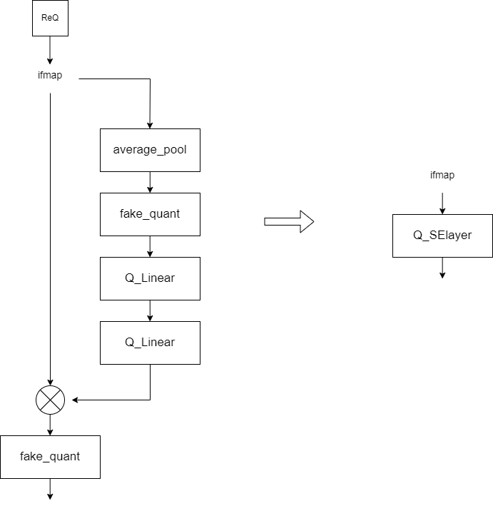
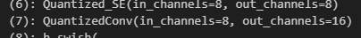
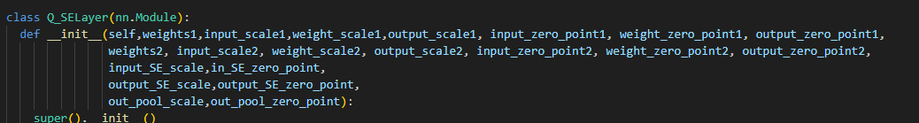
Quantization- Ours
Because of average_pool, We can’t apply Integer-only quantization directly

Slide 15
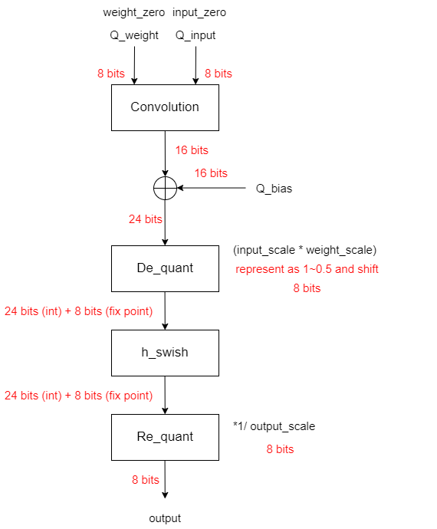
Quantization map to Hardware

Slide 16
Quantization map to Hardware
Software Preprocess

Slide 17
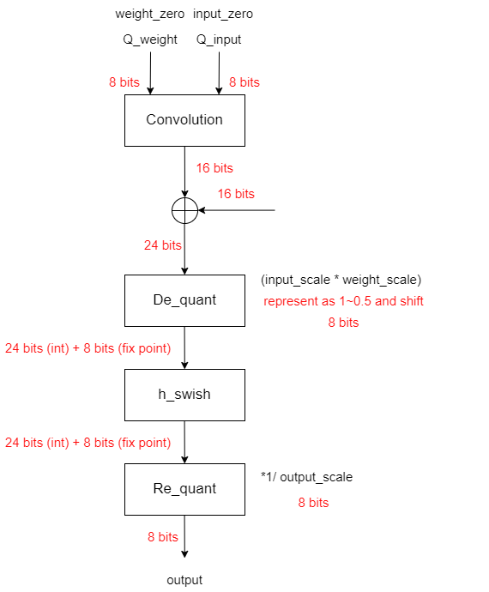
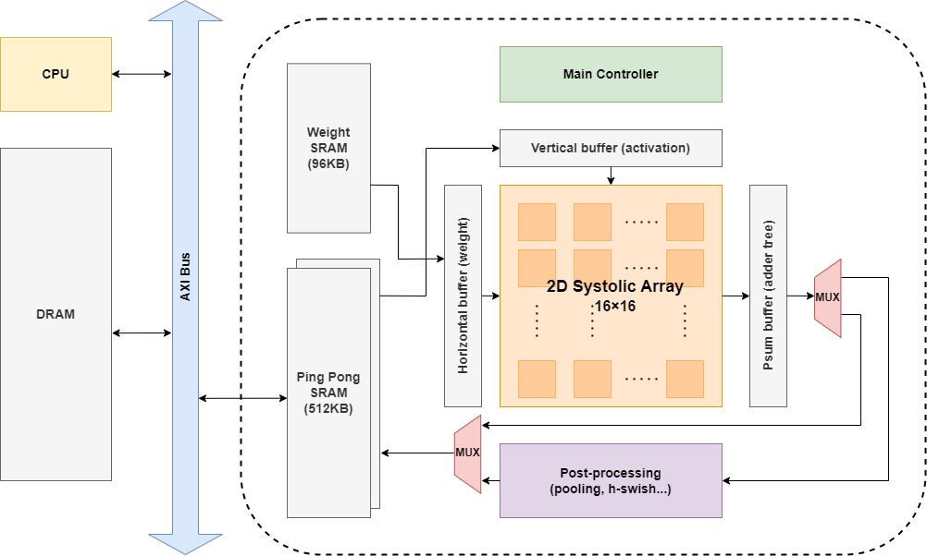
Quantization map to Hardware

Slide 18
Quantization map to Hardware

Slide 19
Quantization map to Hardware

Slide 20
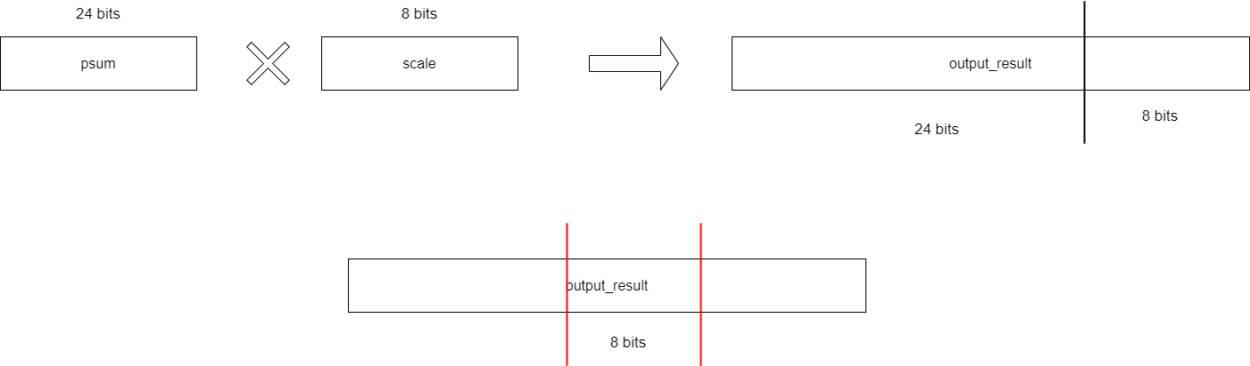
Detail of scaling data by example
If scale is 0.002987524….:
Represent it as a number which is in 1~0.5
0.002987524*256 = 0.764806237… turn it as a fixed point 「11000011」
Input is 24 bits MUL 8 bits = 32bits with 24 bits INT and 8 bit FLOAT
Right Shift 8bits the result and clip FLOAT

Slide 21
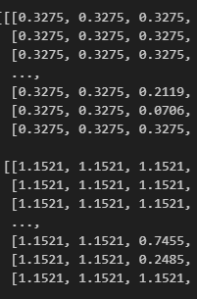
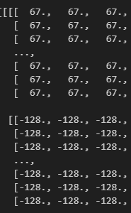
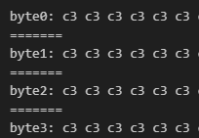
Hex input data generation
(a) Floating data
(b)Int data
(c)To Hardware data(Hex)

Slide 22
Software flow conclusion
Model
Training
BN
Fold
Model
Quantize
Golden
generation
Model | accuracy
Our-mobilenet | 88.1%
BN_fold_our_mobilenet | 88.1%
Q_BN_fold_our_mobilenet | 70.1%

Slide 23
Outline
Software
Hardware
System Overview
Network on Chip
PE Array
Finite State Machine
Improvement
Results and Analysis

Slide 24
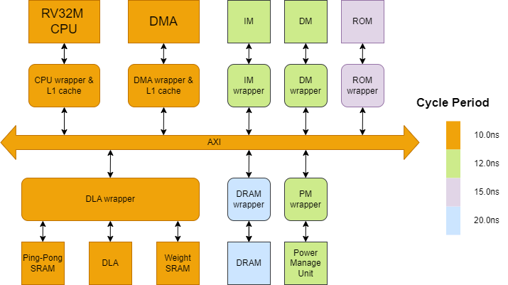
System Overview

Slide 25
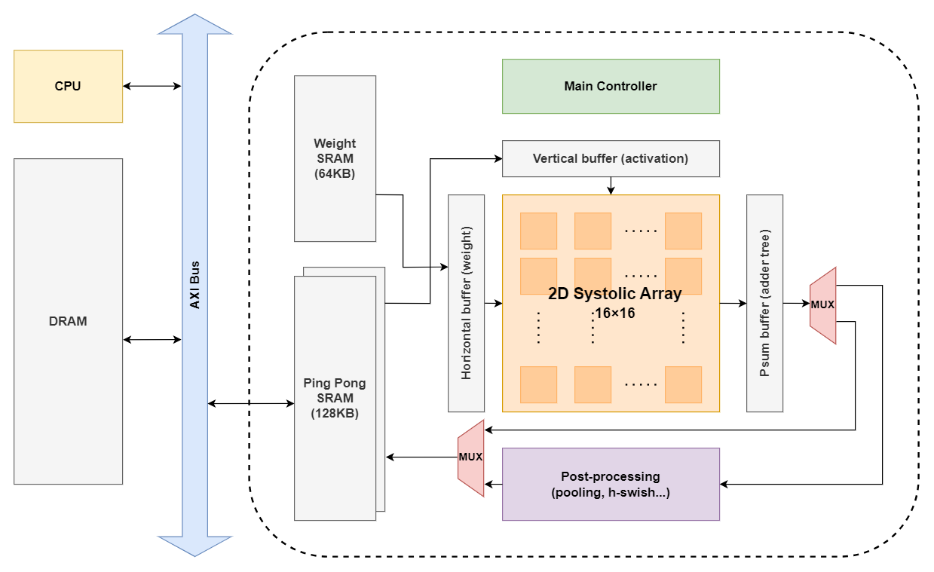
System Architecture

Slide 26
Spec.
PE array : 16 * 16 PEs
DLA Storage size
Registers : Vertical Buffer + Horizonal Buffer + PE Array + Psum Buffer + Pipeline registers
= 16*4 + 256*4 + 256 + 32 + 16*2 = 1408 Byte
Ping-Pong SRAM : 128 KB
Weight SRAM : 64 KB

Slide 27
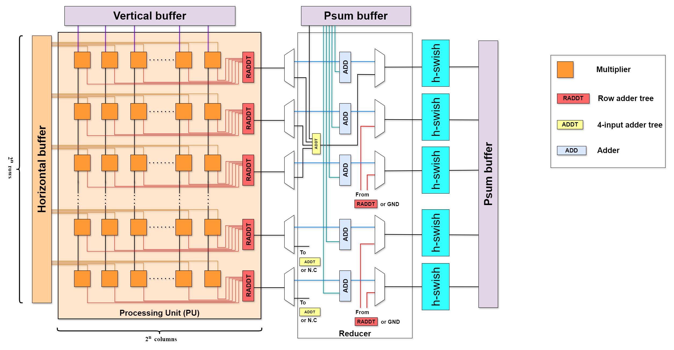
Network on Chip

Slide 28
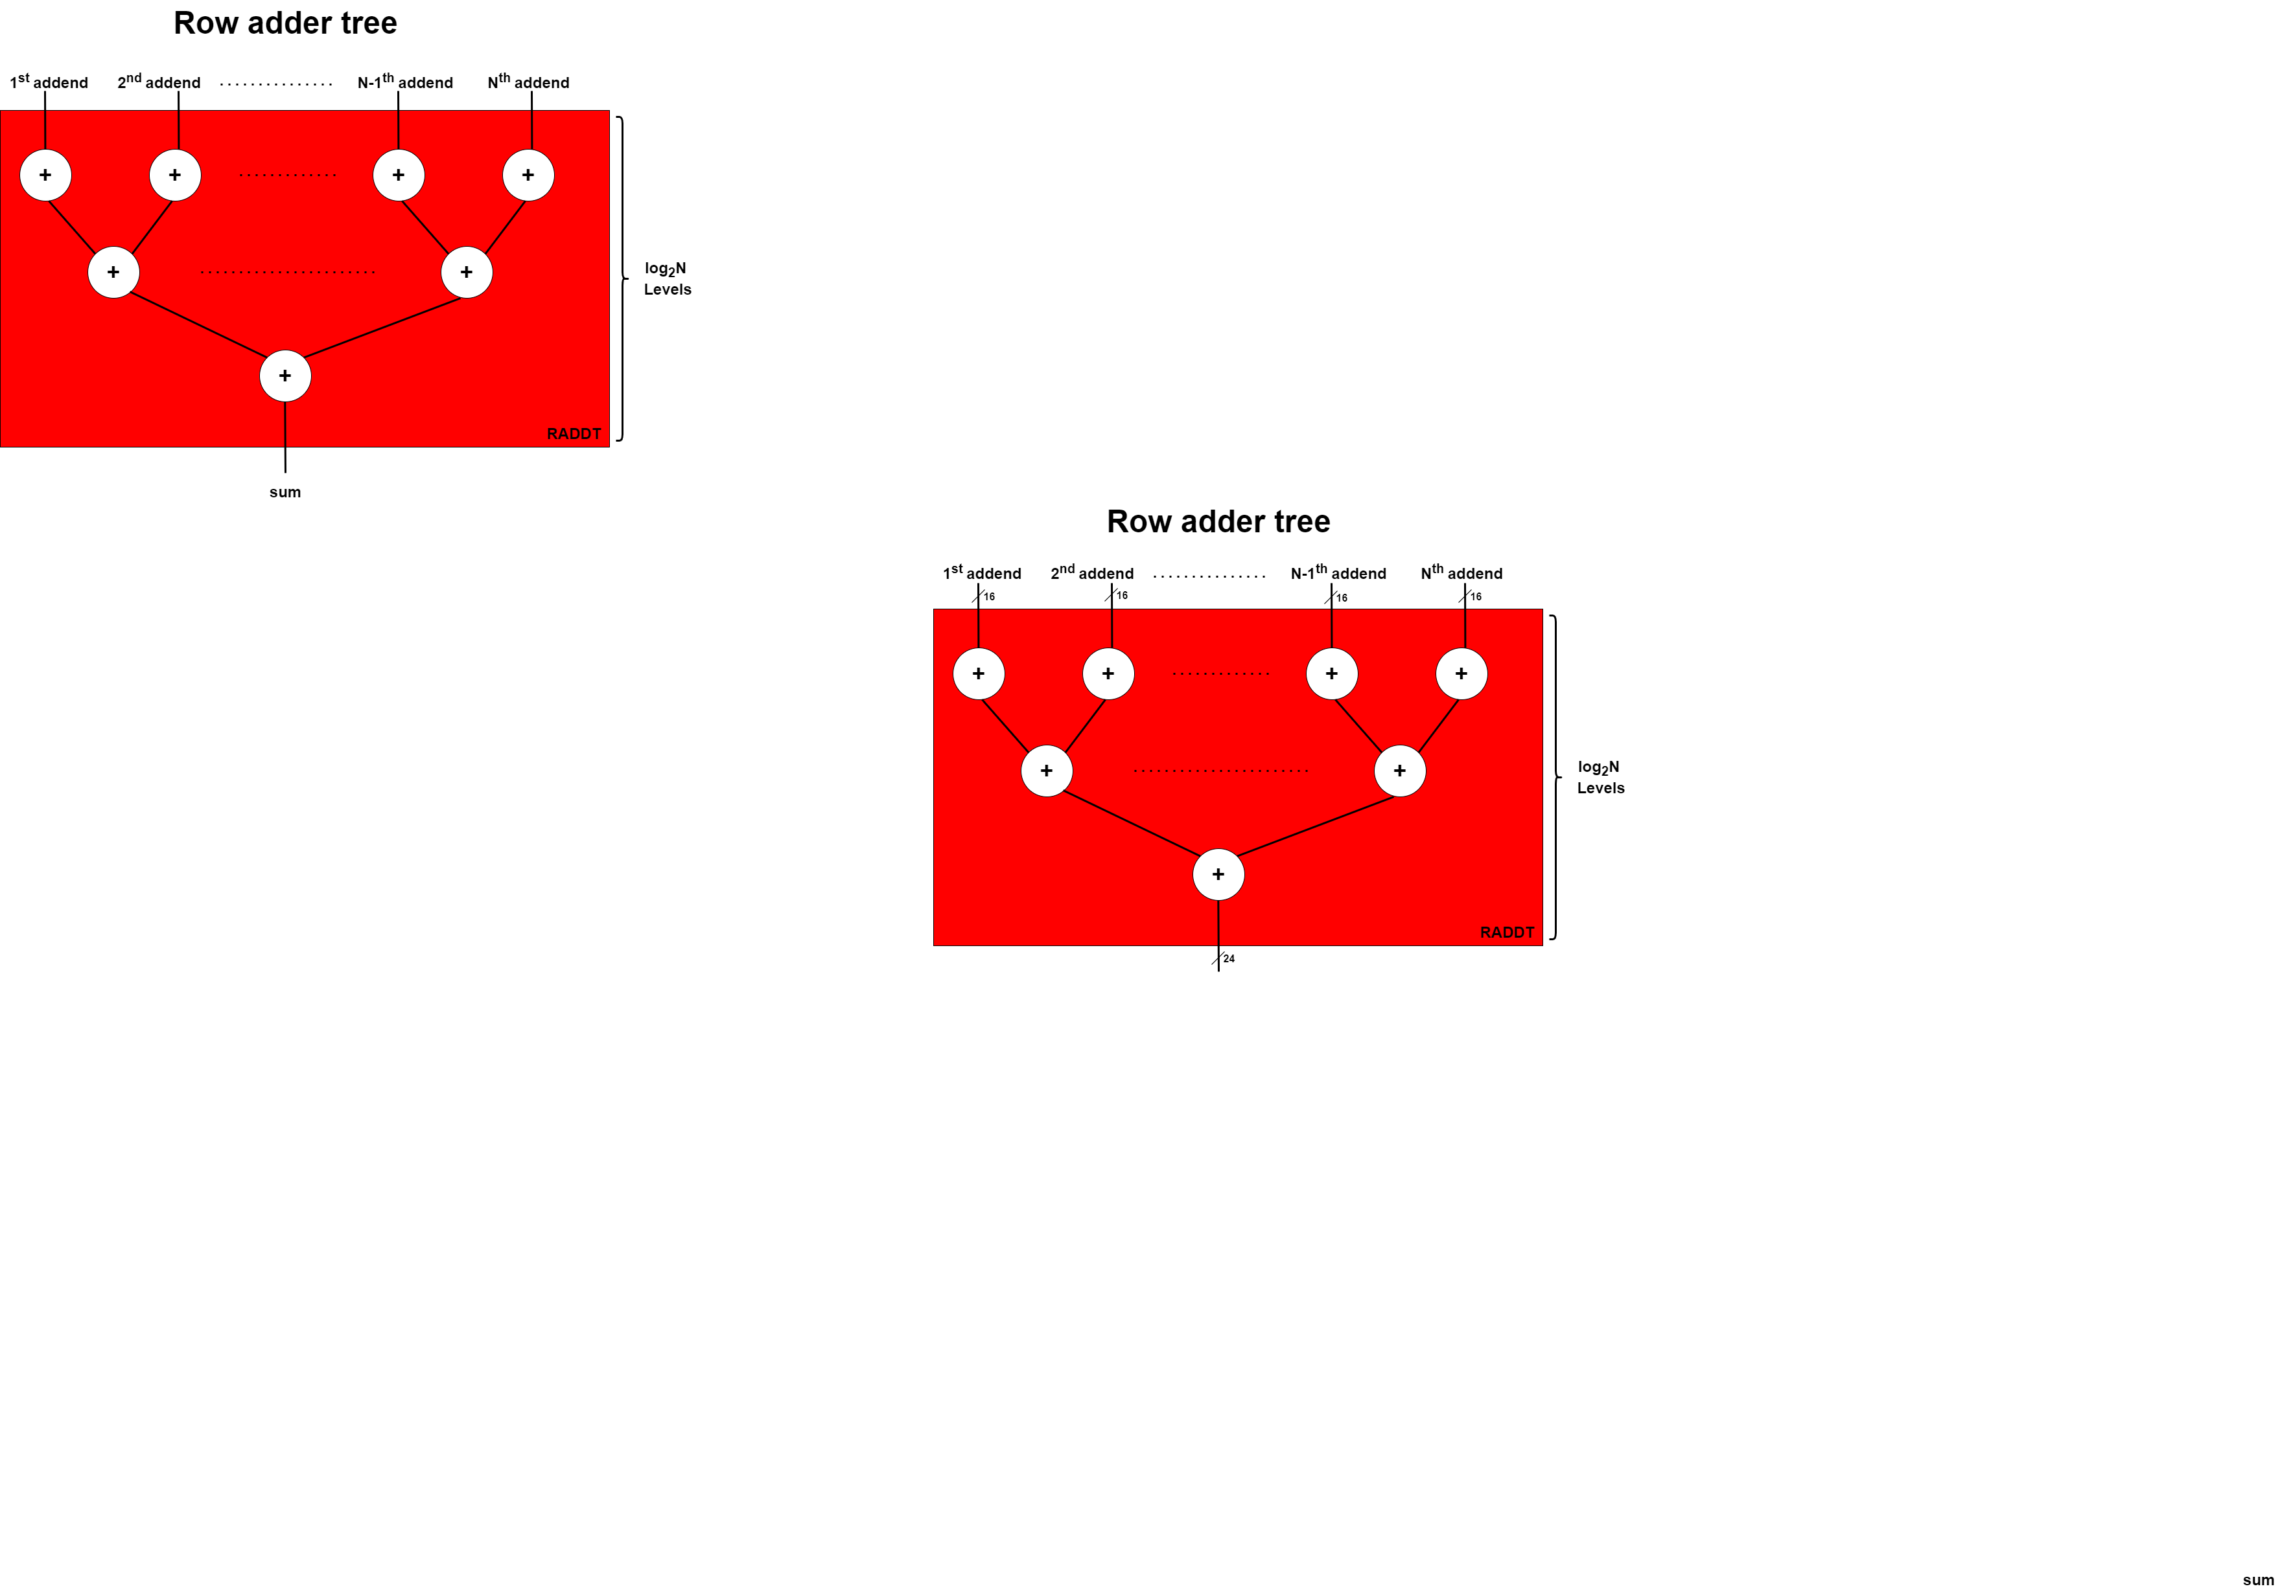
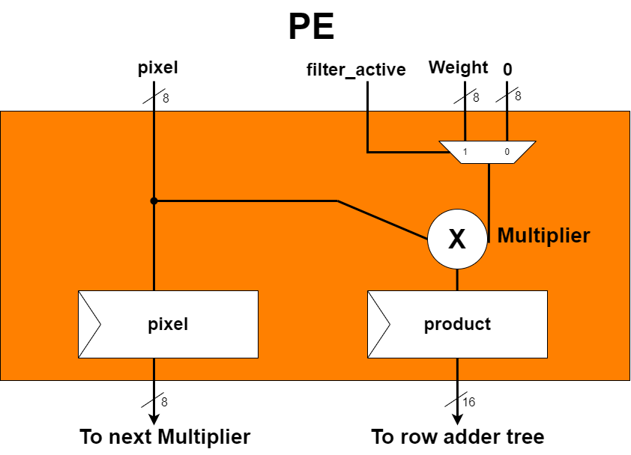
Processing Element

Slide 29
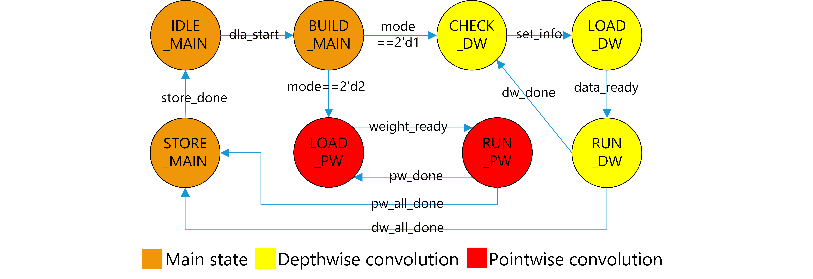
Finite State Machine

Slide 30
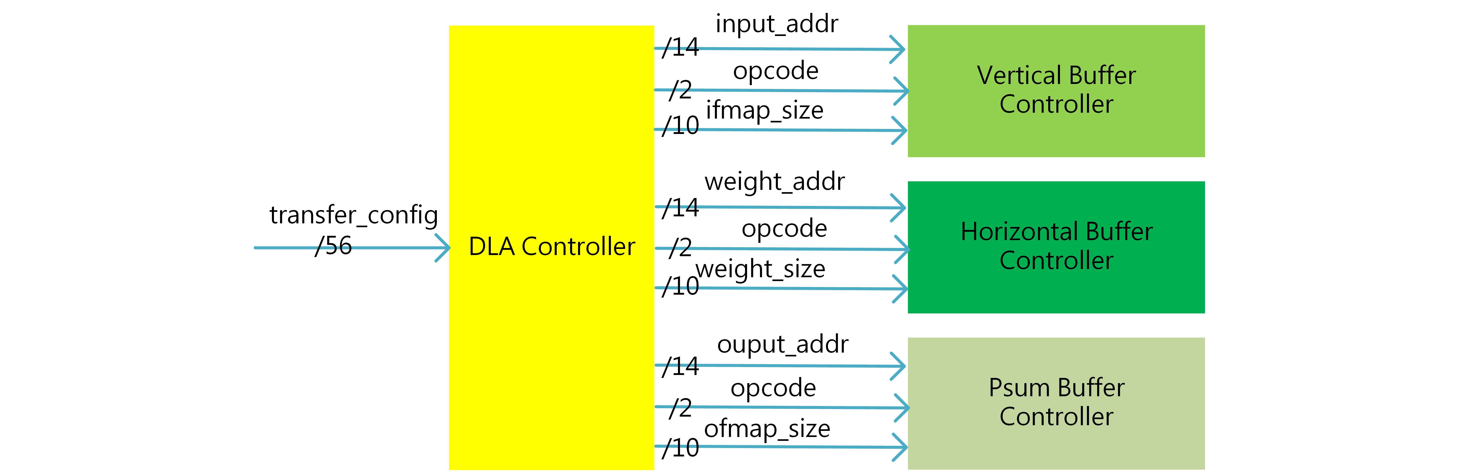
Configurable Controller

Slide 31
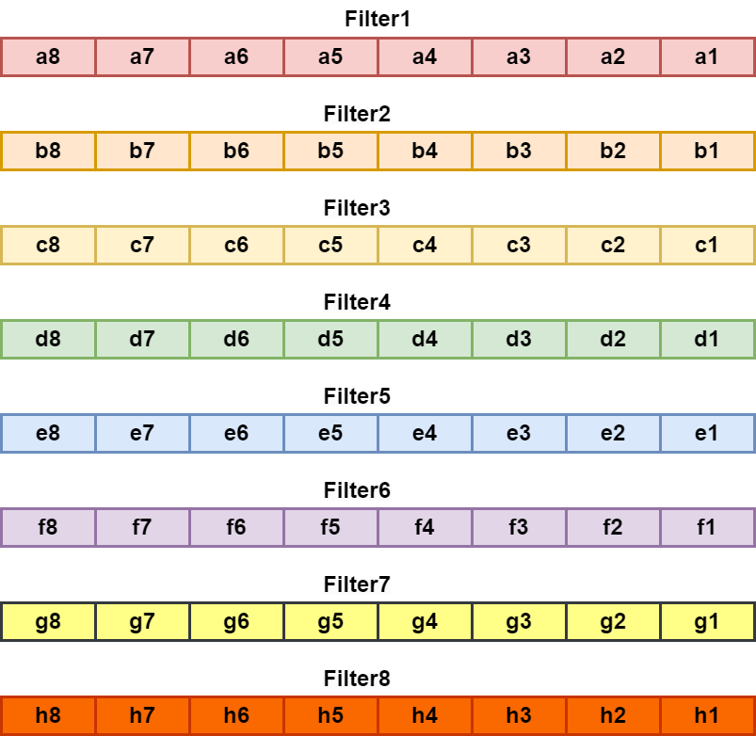
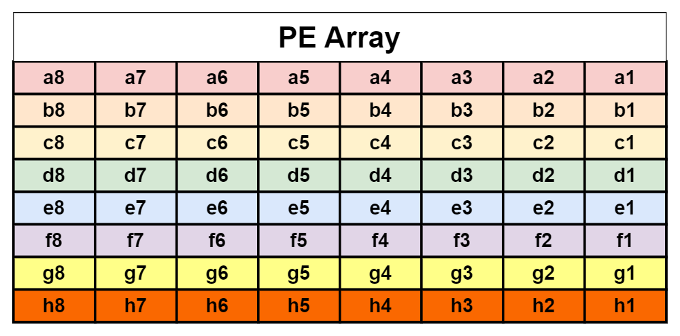
Memory Mapping –Pointwise Convolution

Slide 32
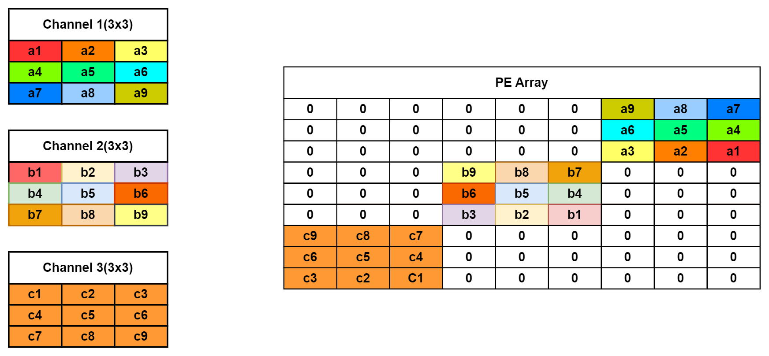
Memory Mapping – Depthwise Convolution

Slide 33
Improvement
H-swish module
Ifmap data bubble design
Optimize Depthwise convolution
Implement weight active design

Slide 34
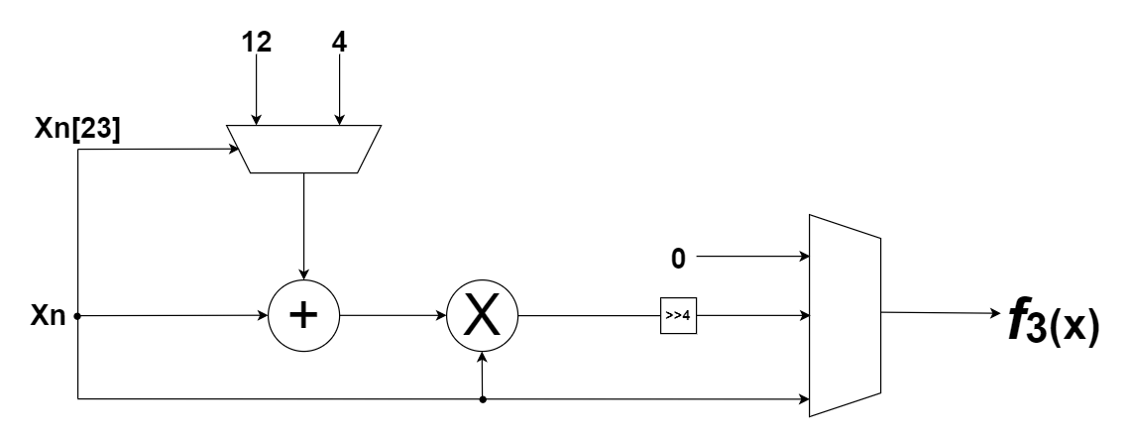
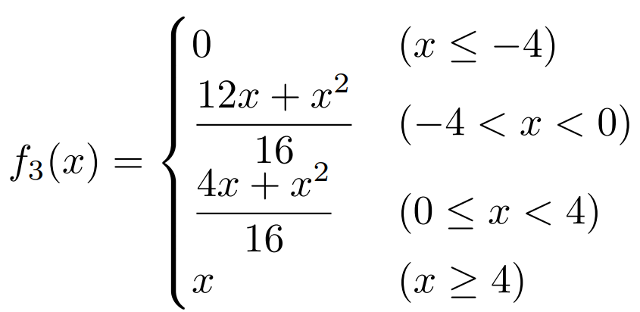
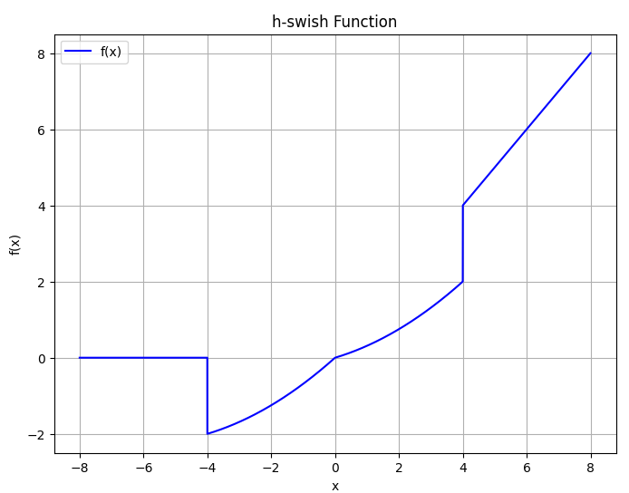
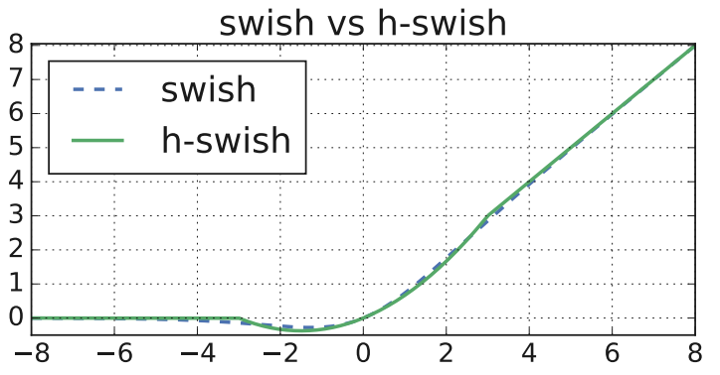
h-swish module

Slide 35

Ifmap data bubble tolerate design
Output Valid
Output Valid
Output Valid
Output Valid
Output Valid
Output Valid
Output Valid
Output Valid
Output Valid

Slide 36

Optimize Depthwise Convolution - Shortcut Strategy

Slide 37

Weight active design-pointwise convolution

Slide 38

Weight active design-depthwise convolution

Slide 39
Outline
Software
Hardware
Results and Analysis
Results
Verification
Problems
Future work
Conclusion

Slide 40
Analysis
BUS transfer: 75.2MB/s
MAC：800M FLOP (28*28*8*8 MAC in 62875 ns)
BUS transfer: 400MB/s(Best case)
MAC：1600M FLOP (28*28*8*16 MAC )
I=75.2×106800×106​=75.2800​≈10.64 FLOP/byte
Notes:
PE 使用率
Configurable

Slide 41

Time vs Activity
在 U18 製程下，使用 spyglass 進行 power 分析
Data transfer phase
Other operations
Notes:
PE 使用率
Configurable

Slide 42
Critical Path
Critical Path: From row adder tree to h-swish
Sol : set pipeline register

Slide 43

Performance (DLA)
Clock period | 10 ns
Area | 13.3909 mm²
Power | 261.9147 mW

Slide 44

Problems
The quantization computation at h-swish module is too complex and the quantization is large
The psum buffer need the ability to stall the whole DLA

Slide 45
Future work
Utilize GEMM to store ifmap data in memory for depthwise convolution, thereby reducing hardware load.
When the psum buffer is full, pause the DLA operation and store the data back to SRAM.
The psum buffer needs to be able to access data from the data SRAM for accumulation.
Using the existing PE array for average pooling to achieve hardware reuse.
Notes:
Use GEMM to store ifmap data in memory for depthwise convolution，減少硬體負擔
將Psum buffer滿的時候，整個DLA會暫停運算，將資料先存回 sram
Psum buffer需要有能力將資料從data sram拿出來，進行累加
利用現有的PE array完成 global average pooling
優化h-swish算法,減少computation error

Slide 46
Reference
K. Choi, S. Kim, J. Kim and I. -C. Park, "Hardware-Friendly Approximation for Swish Activation and Its Implementation," in IEEE Transactions on Circuits and Systems II: Express Briefs, doi: 10.1109/TCSII.2024.3394806.
Howard, Andrew, et al. "Searching for mobilenetv3." Proceedings of the IEEE/CVF international conference on computer vision. 2019.
Chong, Yi Sheng, et al. "An energy-efficient convolution unit for depthwise separable convolutional neural networks." 2021 IEEE International Symposium on Circuits and Systems (ISCAS). IEEE, 2021.

Slide 47
Thank you !

Slide 48
Appendix

Slide 49

Area

Slide 50


Slide 51


